Slide 1
A Machine Learning Approach to Performance and Dropout Prediction in Computer Science: Bangladesh Perspective
Nurjahan Akther Mim 221-15-4782
Mostaque Shahriar Tonmoy 221-15-6052
Arnub Datta 221-15-4726
Abu Zahed 221-15-4716
Bashirul Haque Shuvo 221-15- 5682

Slide 2
TABLE OF CONTENTS
Abstract
Introduction
Literature Review
Research Methodology
Main Work
Results Analysis
Limitation
Future Work
Conclusion

Slide 3
ABSTRACT
High dropout rates in Computer Science are driven by enrollment trends neglecting student capabilities.
Used machine learning (SVM, naïve Bayes, neural networks) on C.S. student data to predict future performance and dropout likelihood.
The focus is to identify critical factors that are strongly linked to a student's success in Computer Science.
Relevant insights are applicable to educational policy formulation and guidance for prospective C.S. students.
The study reflects the challenges and patterns specific to the C.S. education landscape in Bangladesh.

Slide 4
INTRODUCTION:
Rising dropout rates among C.S. students globally pose significant educational challenges that hinder global development.
Dropout reasons in C.S. include personal (knowledge gaps, finances, psychology) and institutional factors (teaching, skills, management).
Final CGPA and Programming skills signify success or dropout likelihood in C.S. students.
Challenges in datasets limit the full evaluation of C.S. student performance.

Slide 5
RESEARCH OBJECTIVES
Dropout Analysis
Investigate reasons behind the dropout rates among Computer Science graduates, focusing on personal and institutional factors.
Predictive Metrics
Determine the predictive significance of final CGPA and Programming skills in evaluating success and dropout likelihood.
Dataset Enhancement
Utilize diverse data parameters including programming skills, and previous academic records to enhance predictive models.

Slide 6
RESEARCH GOALS
Comprehensive Analysis
Conduct an extensive analysis of personal and institutional factors affecting dropout rates among Computer Science students.
Predictive Precision
Enhance predictive models to accurately identify factors influencing success and dropout, emphasizing improved accuracy.
Bridging Educational Gaps
Address gaps in understanding Computer Science education by utilizing data from varied sources to predict success among prospective.

Slide 7

RESEARCH QUESTIONS
Understanding Dropout Triggers
What personal and institutional factors predominantly contribute to the dropout of Computer Science graduates?
Predictive Indicator Significance
How do final CGPA and Programming skills correlate with the success and dropout tendencies of Computer Science students?
Dataset Limitations
What are the key limitations within existing datasets that affect the comprehensive evaluation of Computer Science student performance and dropout?

Slide 8

LITERATURE REVIEW
Diverse Features in Dropout Predictions
(Ahmed and Khan)
Impact of CGPA and Programming Skills on Dropout
Comprehensive Attribute Usage in Dropout Prediction (Vinayak and Prageeth)
Different Data Sources in Dropout Prediction Models (Costa et al. )
Performance Prediction Tools and Algorithms (Goga et al.)

Slide 9
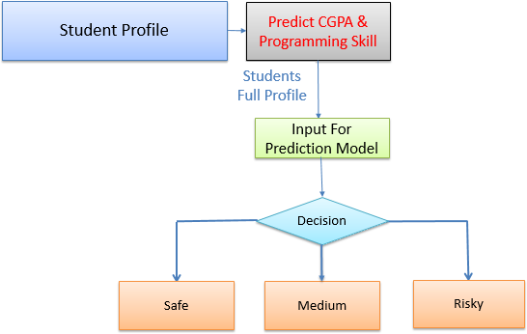
RESEARCH METHODS
Data Collection and Preprocessing
Employed questionnaires via IBM SPSS and Google Forms.
Feature Selection
Generated a new feature classifying profiles as Safe, Medium, or Risky.
Utilized cfsSubset, GainRatio, and Correlation algorithms from Weka for attribute selection.
Data Mining Approach (Clustering)
Prediction of programming skill, CGPA, and dropout likelihood

Slide 10
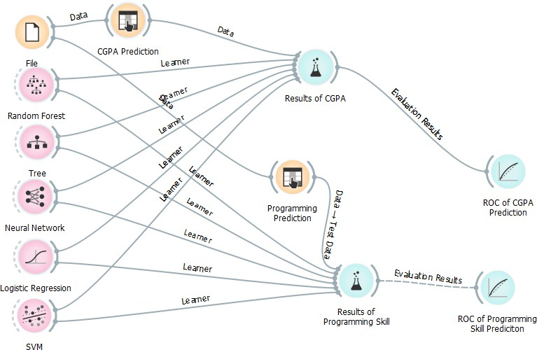
CONCEPTUAL DIAGRAM

Slide 11
MAIN WORKS
Identification of Influential Features
Identified the ten most impactful features crucial for success in Computer Science Engineering (C.S.E.).
Creation of Dropout Prediction Model
Established a model to predict prospective dropouts in C.S., aiding in early alert systems.
Dropout Prediction using Class Labels
Utilized classifiers like Neural Network, Random Forest, and Decision Tree to predict prospective CS students' graduation likelihood.
Evaluation Metrics and Results
Achieved high accuracy across classifiers, with Neural Network delivering the best performance.

Slide 12
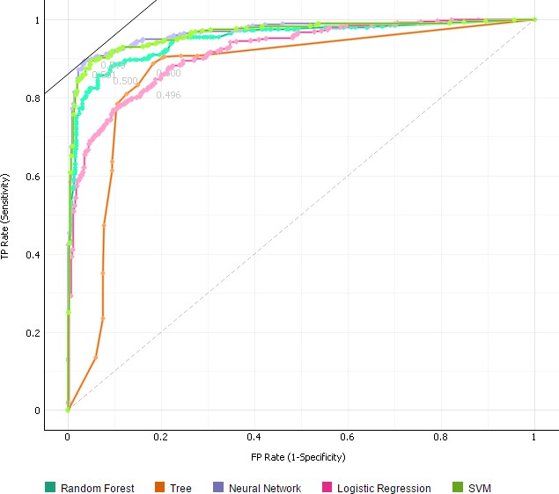
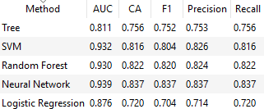
RESULT ANALYSIS
Result of CGPA Prediction

Slide 13
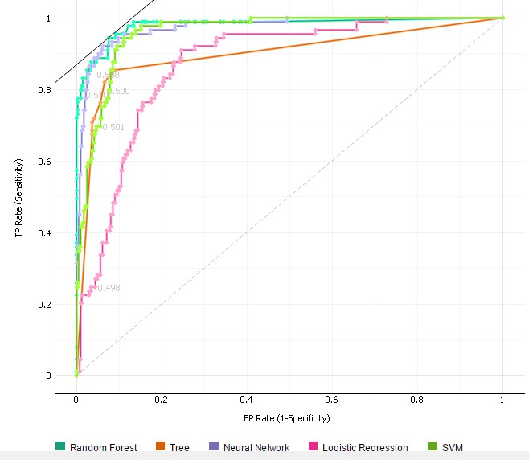
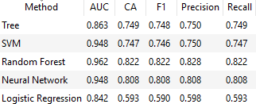
RESULT ANALYSIS Cont...
Results of Programming Skill Prediction

Slide 14
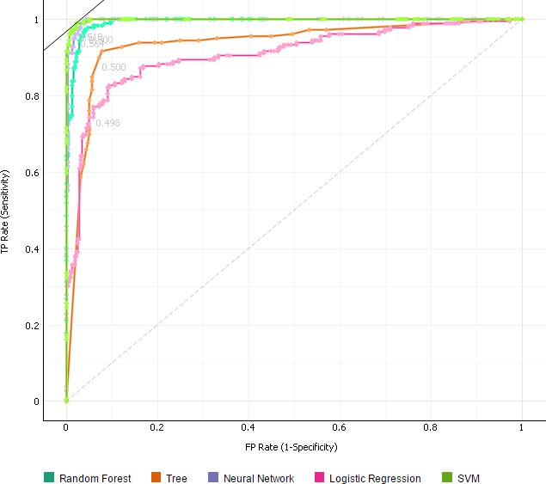
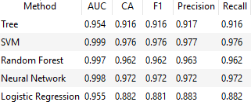
RESULT ANALYSIS Cont...
Results for Predicting Dropout

Slide 15
Limitation
Scope Limitations
The study focuses on Computer Science students in Bangladesh, potentially limiting generalizability to other disciplines or regions.
Data Dimensionality
Limited dimensionality in the dataset may affect the comprehensiveness of the predictive model.
Subject Specificity
The research primarily targets Computer Science graduates, potentially neglecting insights applicable to other engineering disciplines.
Programming Knowledge and Analytical Ability
While programming skills were considered, the depth of analysis on other critical skills like analytical ability could be enhanced.
Survey Scope
The survey might not cover all possible factors influencing dropout, and certain nuances might be missed.

Slide 16
Future Work
1. Expanded Scope
2. In-depth Skill Analysis
3. Multidimensional Dataset
4. Comparative Analysis
5. Institutional Focus
6. Longitudinal Study
7. Cross-Cultural Comparison
8. Integration of Advanced Algorithms

Slide 17
CONCLUSION
Achieved an exceptional 98.2% accuracy using the Neural Network model.
CGPA and Programming Skill crucial in predicting dropout rates and guiding informed decisions for students.
Provides proactive insights into pre- and mid-undergraduate studies, aiding in optimizing academic performance.
Offers actionable advice for enhancing CGPA and programming skills, shaping successful career paths.
Applicable beyond CS undergraduates, relevant for diverse academic fields.
Signals a shift towards predictive analytics in education, fostering proactive support and academic excellence.

Slide 18
THANK YOU!😃

